Slide 1
Raspberry Pi
Eric Daugherty

Slide 2
Introduction
The Raspberry Pi project is one that gives an introduction into “Internet Of Things”, it gives a chance for inventors, hobbyists and students to try different projects and prototype projects they are working on. This project is a great introduction into electronics, giving the chance to wire up LED’s and temperature sensors, it also allows to give a different look into problem solving, instead of identifying a problem within software this gives a chance that the electronic portion is the problem. Doing this project will give the user the ability to control real world objects with software. This project also makes a person think of how to design their code and how to wire the electronics. You will need to install a G++ compiler to compile the C++ code to create the executable. Using the command line where the user can enter a flag to use the different functions or if they want to see a menu then they will enter no flag and the menu will display with the options. Once a selection is made it will give the user an output of their option. There is also a web interface that allows access from the IP of the Pi to access a web interface to complete certain tasks with the LED and temperature sensor.

Slide 3
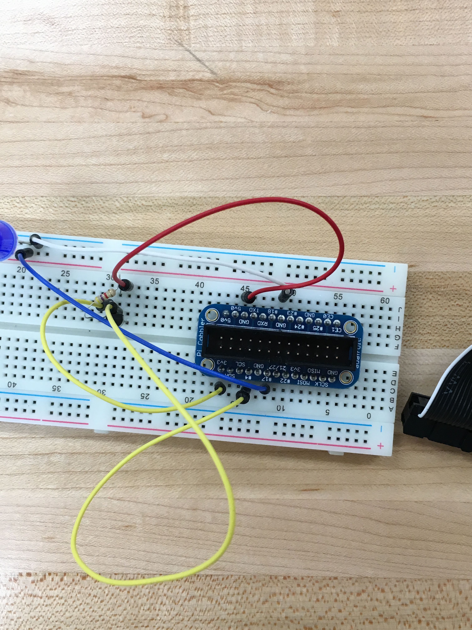
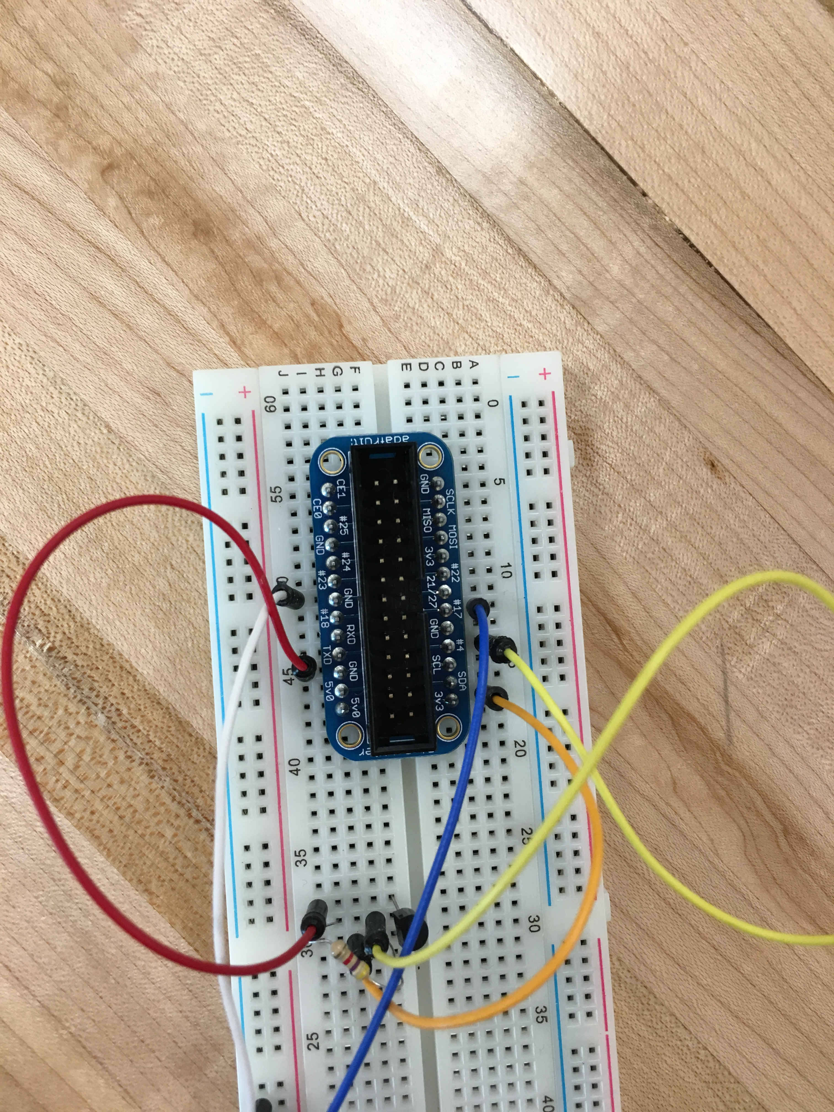
Hardware
Raspberry Pi
BreadBoard
LED
DS18B20 Temperature Sensor
Male to Male Cables
Pi Cobbler Extension Board
4.7kΩ Resistor

Slide 4
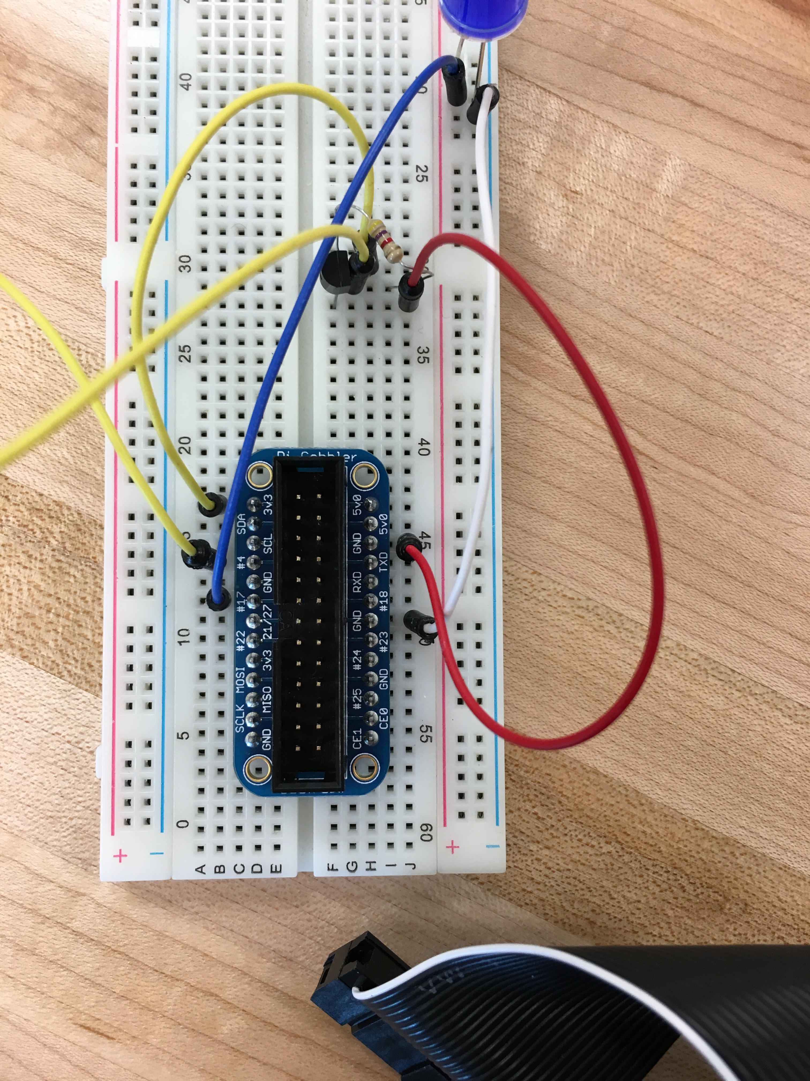
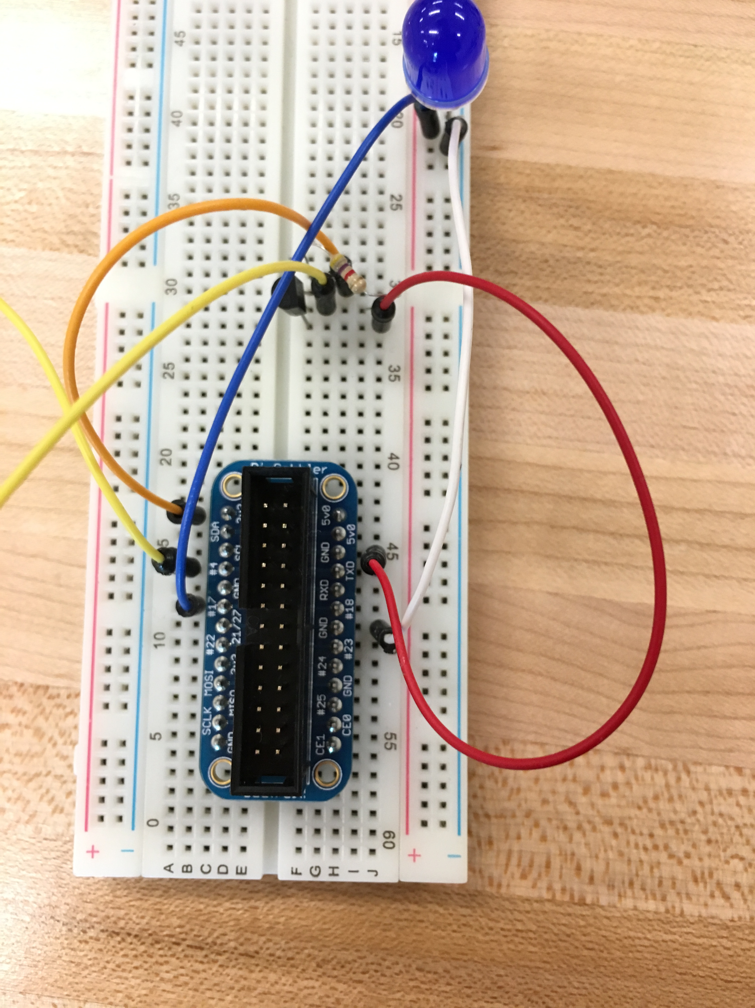
Wiring
LED
Blue lead – GPIO 0(Pin 17)
White lead – GND(GROUND)
TEMP SENSOR
Yellow lead – GPIO 7 (Pin 4)
Orange Lead – 3V
Red Lead – GND(GROUND)

Slide 5
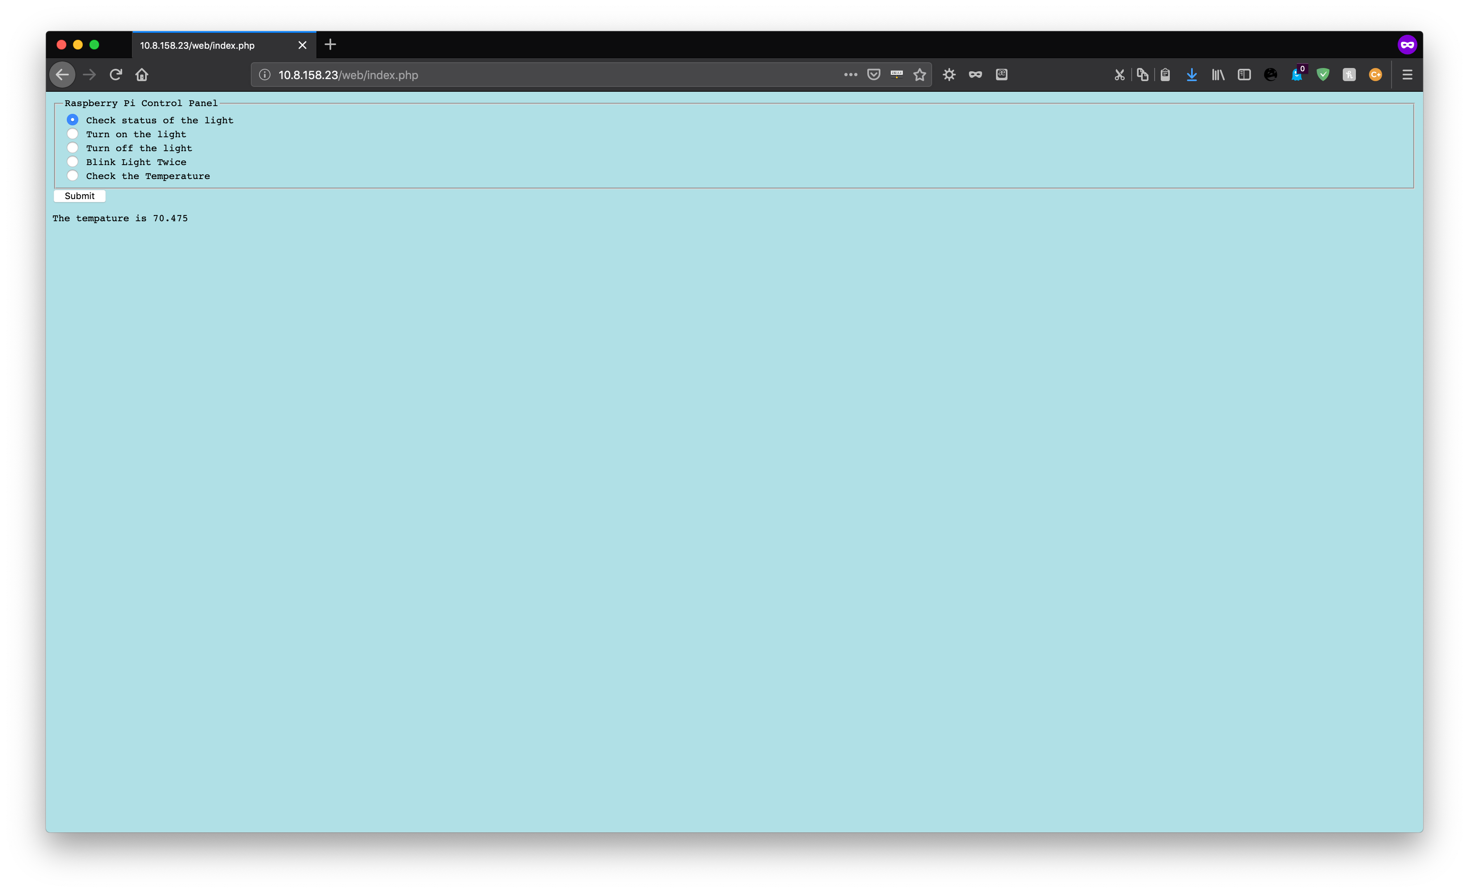
Web
Command: cd Blink
Command: sudo g++ -Wall –o b blink.cpp –lwiringPi
Command: sudo cp b web/b
Command: sudo cp –r web /var/www/html/web
Command: sudo chmod 4755 /var/www/html/web/b
To get web, find Pi IP address and put that into URL (ex: 10.8.158.23/web/)

Slide 6
Testing
Command: cd Blink
Can use different flags, for example: ./b o
s – Get light status
o - Turn light on
f – Turn light off
b – Make light blink
t – Check the temperature
./b and no flag will display a menu for selection

Slide 7
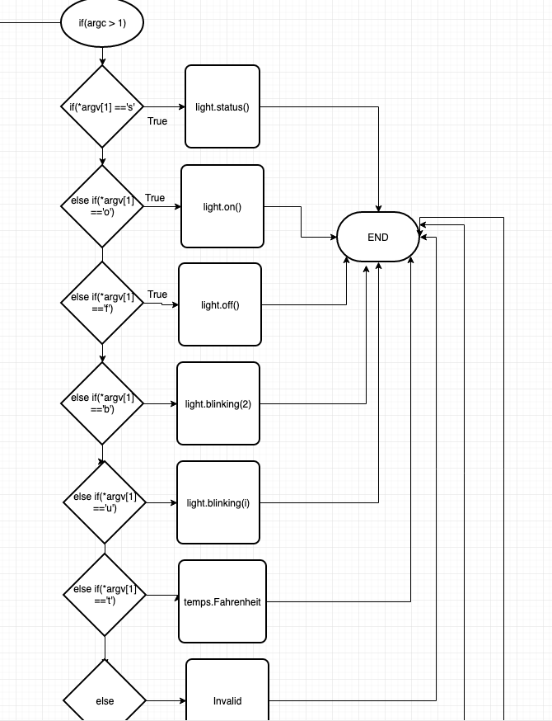
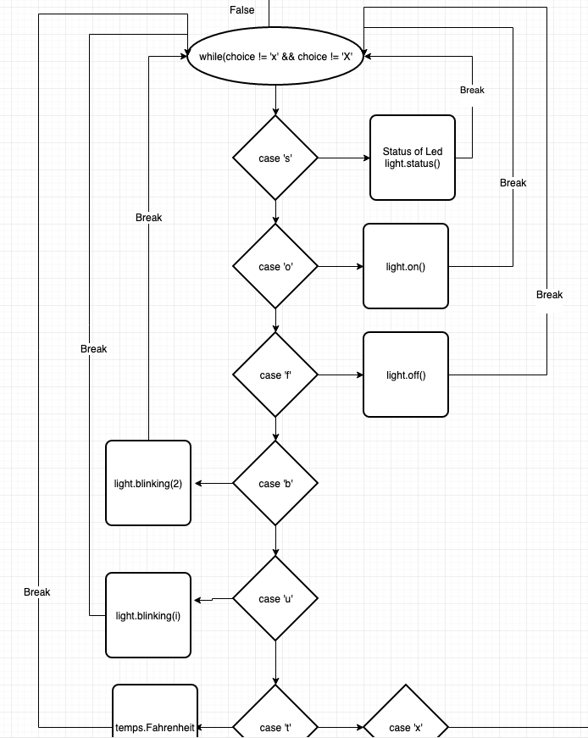
Flowchart

Slide 8
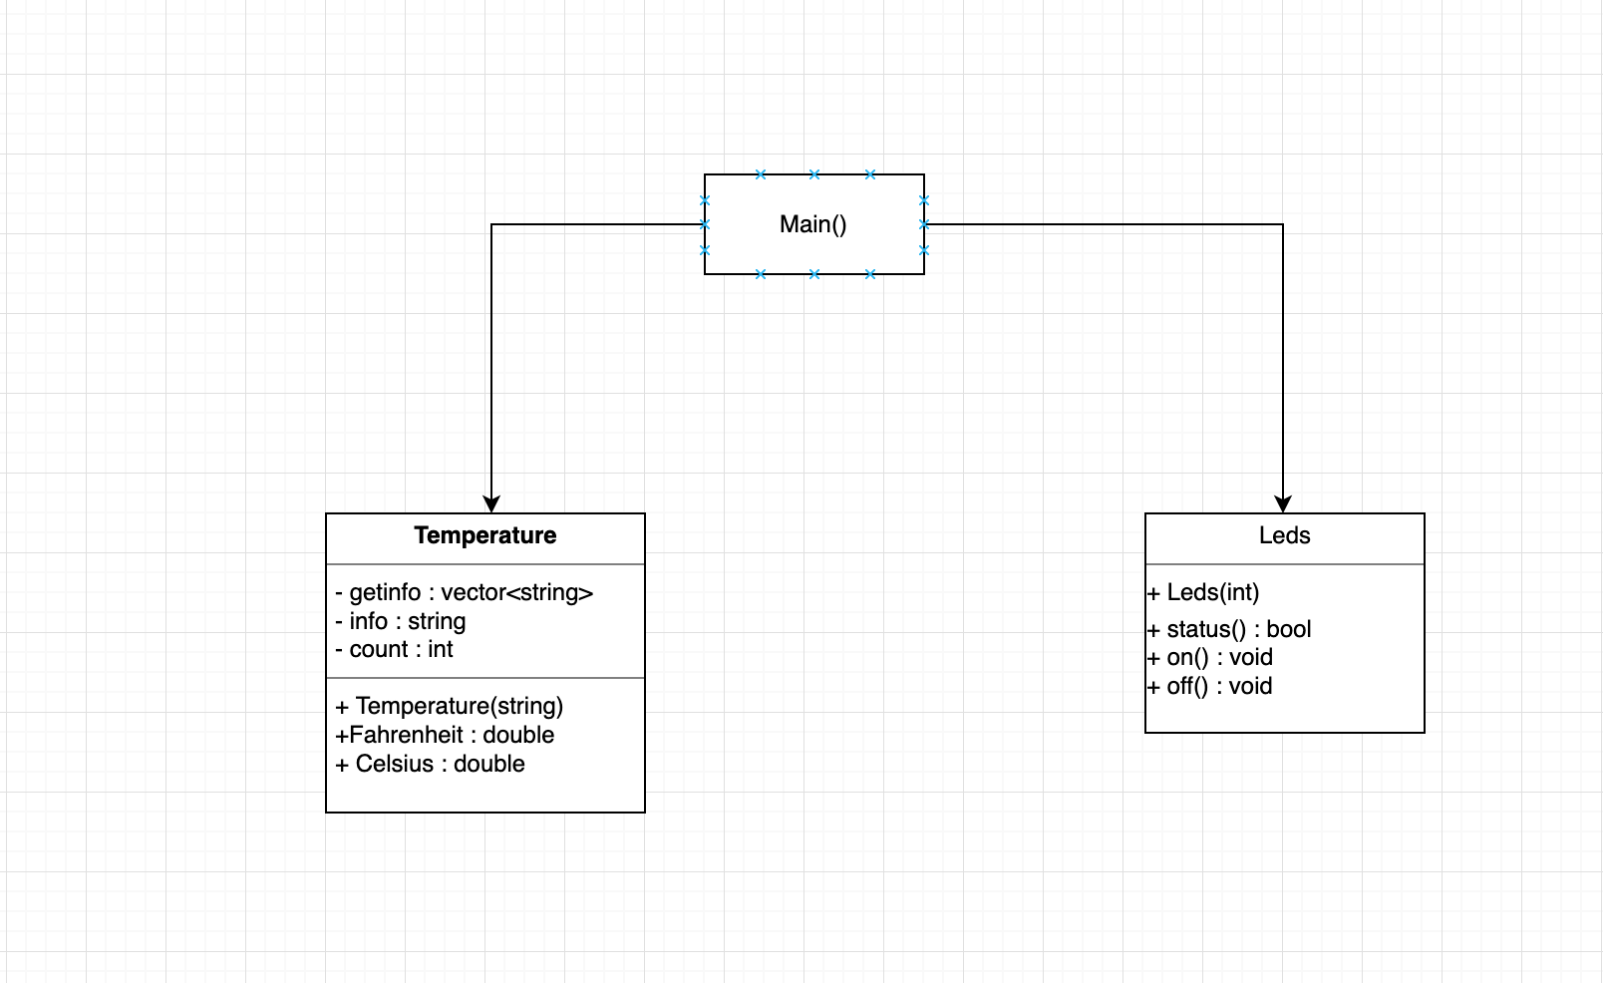
UML

Slide 9
